Slide 1
How to win the 3 minute thesis
Dr Inger Mewburn (aka @thesiswhisperer)
Director of research training
The Australian National University
www.thesiswhisperer.com

Slide 2
In this presentation we will
Talk about bad presentations
Look at some examples of the 3MT in action
Go through some steps to help you make one

Slide 3
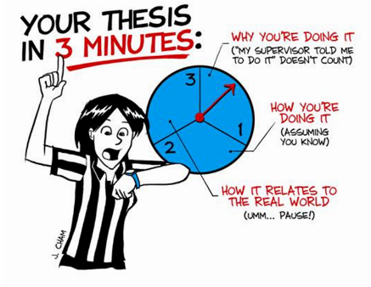
What is the 3MT?
Notes:
An National competition for Australian research students on presenting research to non specialist audiences. The competition asks you to present a oration about what you are doing, how you are doing it and why in a way that engages the audience, without reducing research to purely entertainment value. You do not have to explicitly talk about results, so you can take part in it early in your candidature.
The rules:
A single PowerPoint slide (no slide transitions are permitted).
No additional electronic media are to be used (e.g. sound and video files)
No additional props (e.g. costumes, instruments) are permitted
Presentations are limited to 3 minutes maximum or you will be disqualified
Anyone studying a research degree (Masters or PhD) can take part, even if you have submitted (but not if you expect to receive your results by September the 28th)
The 3MT is an example of a good idea coming to a person while they were in the shower. A professor in engineering at the University of Queensland thought it up and UQ supported the introduction of a national competition in 2010. In 2011 NZ and other pacific nations took up the challenge and now the competition is run all over the world.

Slide 4
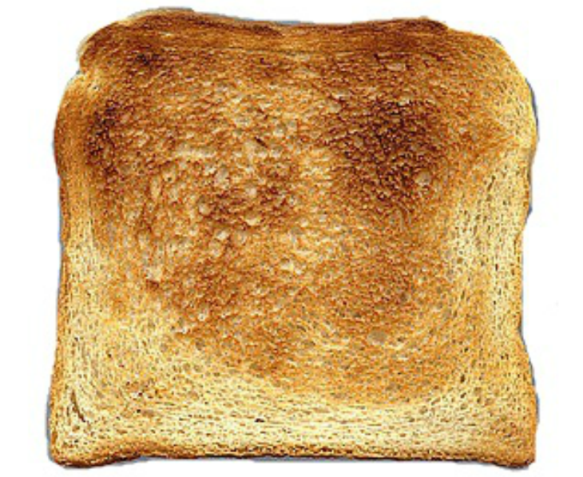
In other words, it shouldn't be like this:
Notes:
Other academics will judge you by how well you present your work. They will be asking themselves:
Can you think and communicate clearly?
Do you pay due respect to the body of knowledge?
Do you have interesting ideas?
Can you ask the right questions?
Do you know the implications of your work?

Slide 5
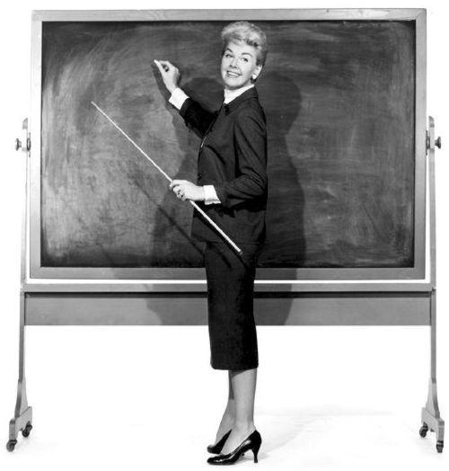
Why are some presentations bad?

Slide 6
What other students have said
Too technical
Too much on each slide
No structure to talk
Reading from notes
Unclear speech
Nervous speaker
Too simple
Weird body language
Small font / wacky fonts / yellow font on white background
Busy backgrounds
Notes:
Too technical – lose interest
Too much on each slide – get lost – try to read while trying to listen is hard!
No structure – doesn’t seem like a ‘story’. Takes too much energy to listen.
Reading from notes - don’t feel involved. Worse if less eye contact.
Unclear speech – not understand or follow what is being said
nervous speaker – makes you feel for them and is distracting
Too simple – feel ‘talked down to’
Body language – too much or not enough
Small font or wacky fonts undermines the authority of the speaker
Lots of different fonts or colours – distracting again

Slide 7
Let's look at some 3MT contestants in action
Barlarka Banerjee
Jack Midalek
Sumaiya Ahmed
Jamie Flynn
Daniel Crabtree
Notes:
Australia & New Zealand 3MT Winner - Balarka Banerjee (The University of Western Australia)

Slide 8
A good 3MT presentation...
Doesn't try to say too much
Is delivered slowly.
Has expression (pauses, rises, falls and stresses)
Includes a story, metaphor or emotional element
Gives concrete examples
Doesn't ‘telegraph’
Tells you things you didn't expect to hear about the topic
Anything else?

Slide 9
A framework for action
In "Made to Stick" Chip and Dan Heath claim that this
formula makes information rich presentations unforgettable:
Simple
Unexpected
Concrete
Credible (we won't deal with this)
Emotional
Stories
Notes:
Simple: Our information environment is noisy and chaotic. If you want ideas to stick you need to aim for elegant simplicity – this is very hard to do. The first step is to identify the core of the idea.
Unexpected: We can't demand attention – we must attract it. The most basic way is to provoke surprise and interest by breaking a pattern.
Concrete: If you can see, hear, touch, smell or taste something it is concrete. Metaphors are useful because they 'borrow' features from the everyday world of experience.
Credible: You borrow credibility from your university and the status of PhD student.
Emotional: You can make people to care more about your research if you can get them feel some degree of emotional engagement. The easy way is to ‘piggy back’ your research on a care or interest that already exists.
Stories: Stories act to draw the audience into the story teller’s world and help us to identify with the scenario being told.

Slide 10
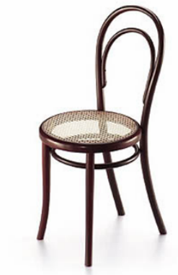
Let's work on Simple
Complete the following sentence.
"The purpose of my research is..." (add max 50 words)
Share your sentence and we'll workshop some of them.

Slide 11
Let's work on Unexpected
Tell us an interesting fact about your research!
All of you will know something that has probably ceased being of interest to you, but is new to us.
For example:
Silver turns your tongue blue.
The chemical that makes bananas go brown probably causes alzheimer disease.
Watering a plant is good because you are giving it electrons.
Take a few minutes to think about it, then share one if you can.
Notes:
We are ‘guessing machines’ always trying to anticipate what is next.
Surprise jolts us out of these habitual patterns and focuses our attention.
But remember - there’s a fine line between surprise and gimmick.

Slide 12
Let's work on Concrete
Close your eyes... and listen to me
Notes:
Remember the capital of NSW
Remember the chorus of your national anthem
Remember the Mona Lisa
Remember the house where you spent most of your childhood
Remember the definition of ‘truth’
Remember the definition of watermelon

Slide 13
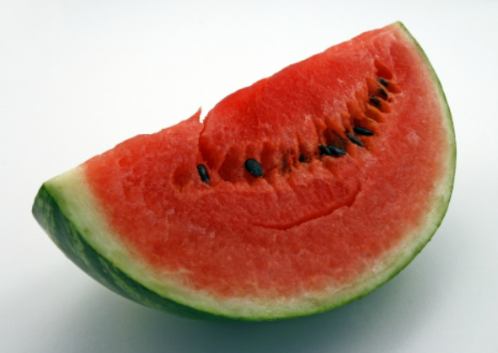
Was it hard not to think of this?
Notes:
Remember the capital of NSW
In your mind, sing your national anthem
Remember the Mona Lisa
Remember the house where you spent most of your childhood
Remember the definition of ‘truth’
Remember the definition of watermelon

Slide 14
Emotions
In research writing we are told not to resort to emotional arguments, but in the 3MT it is essential. Here's some emotions you can work with:
"What's in it for me?" (WIFM)
"Oh, how sad :-("
"Interesting!"
"That's mysterious..."
You need to convey your passion for your work too, but be aware of the possibility of 'topic fatigue' in the audience.

Slide 15
Story
Including a story can help you work in an emotional angle
Good stories include the following elements:
Characters (they don't have to be human)
A beginning, middle and end (not necessarily in that order)
Some kind of change or transformation
A "call to action"
Read this blog post "Story telling in business" for more ideas.
Notes:
Remember the capital of NSW
Remember the chorus of your favourite song
Remember the Mona Lisa
Remember the house where you spent most of your childhood
Remember the definition of ‘truth’
Remember the definition of watermelon

Slide 16
What should go on the slide
Resist temptation!
Don't rely on it as a presentation aide
Choose one 'hero' image or diagram
Title can be a question, or your actual title
Put your name and contact details on it

Slide 17
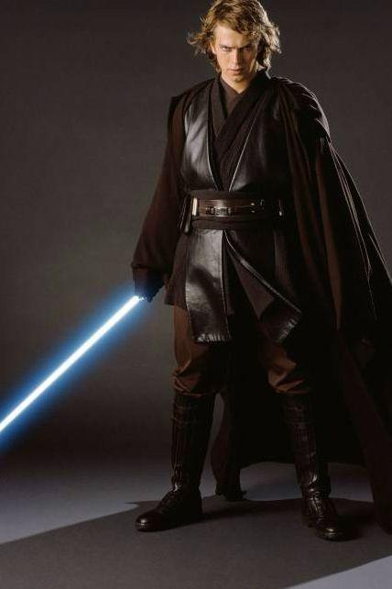
May the force be with you!
For more advice and ideas head to the Thesis Whisperer blog which has a section on presenting

