Slide 1
How youth portray signs of suicide ideation on social media sites: Considerations for educational programs
Jennifer Laffier
University of Ontario Institute of Technology
Ontario, Canada

Slide 2
Literature Review Highlights
Suicide is a leading cause of death for youth in many countries (Wasserman et al., 2012)
Loneliness and depression are the 2 greatest risk factors (American Foundation of Suicide Prevention, 2012)
The escalation of suicidal ideation involves movement from thoughts to behaviors and an increase in intensity and duration (MHCC, 2012)

Slide 3
Youth report increased amount of self-disclosure on-line.
5 most popular youth social sites: MySpace, Facebook, Twitter, blogs, YouTube, and Tumblr (Zakik & Park, 2013).

Slide 4
Two views on the link between social media and suicide
Social media increases the risk of suicide
a ‘how to’ dictionary
‘Pro-suicide’ sites
suicide contagion effect
suicide clusters
Attracts negative attention
Communicating with known-others was found to have more of a beneficial impact while communicating with strangers was found to have more of a negative impact on relationship quality (Blais et al., 2008).
Many people tend to respond negatively to people suffering depression increasing their isolation and feelings of loneliness (Bertera, 2007).

Slide 5
Social media can decrease the risk
a) information and crisis support
b) support groups
c) screening and intervention measures
by social media sites
d) early support and identification
by peers and family

Slide 6
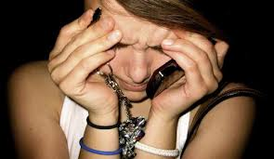
Most suicide screening tools and trainings do not consider the online presentation of signs and symptoms of suicide.

Slide 7
A Whole New World
Research Question
(1) How can themes of suicidal ideation and severe depression be presented within an online environment by youth ?
2) How can awareness of these themes be used to create educational programs within schools?

Slide 8
Qualitative Case Study
A case study design to describe context and illustrate participants’ realities and actions.
Small sample size of 10 to uncover patterns of meanings and identify themes.
Selection criterion included:
(1) current or prominent cases in the media to increase available data sources on each case
(2) adolescents similar in age range in order increase reliability of cross-case comparisons
(3) adolescents that used social media
Content Analysis of public records to identify themes of suicide ideation and severe depression.
Themes of suicide ideation were devised from a previous checklist (Laffier, 2013, in press).
Individual case studies are presented first then a cross case comparison.

Slide 9
Signs and Symptoms Checklist: 9 symptoms & 12 signs & 8 risk factors
s
Hopelessness Expressing wish to die
Depression /Emotional pain Having a suicide plan
Desperation Isolation/social withdrawal
Loneliness Getting affairs in order
Thwarted belongingness (perception of social failure, not belonging) Inability to cope (self- medication
Pessimism/negative thoughts Confusion, risky behavior
Anxiety/agitation Making amends
Low self-esteem/ feelings of worthlessness Pre-occupation with death
Anger Giving items away
Saying good-bye Excessive crying
Sleeping/eating difficulties

Slide 10
Sample
10 youth suicides
Canadian and American youth
Ages 14-19 yrs. old
Used a variety of social media:
Facebook
Youtube
Tumblr
Veimo
Twitter

Slide 11
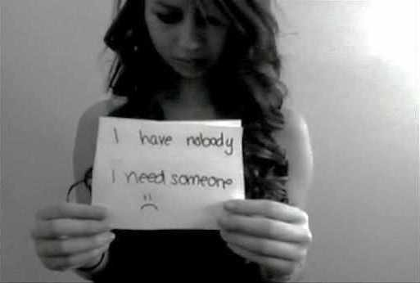
Amanda Todd
Amanda was a Grade 10 Student from B.C. She
suffered from anxiety, depression, & eating disorders.
She was a victim of online bullying and sexual
harassment. She used Facebook and YouTube to express
herself and create videos. Left suicide note as video for
Mother.
“Life’s never getting better”
“I’m constantly crying now”
“I wanted to die so bad....when he brought
me home I drank bleach”
“I have nobody I need someone”
Amanda posted a 13 min. suicide video on You Tube before taking her own life on October 10th 2012

Slide 12
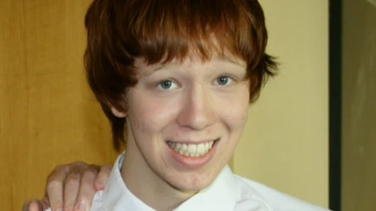
Jamie Hubley
Jamie was a grade 10 student from Ottawa. He was openly
gay and suffered from years of ridicule from peers.
Jamie used social media sites such as tumblr and his own blog
to write poems, post pictures, and journal feelings. Left suicide
note on tumblr.
“I can’t take it anymore”
“This hurts too much”
“I wish I could be happy, I try, I try, I try, I just
want to feel special to someone”
Died by suicide on October 14th 2011

Slide 13
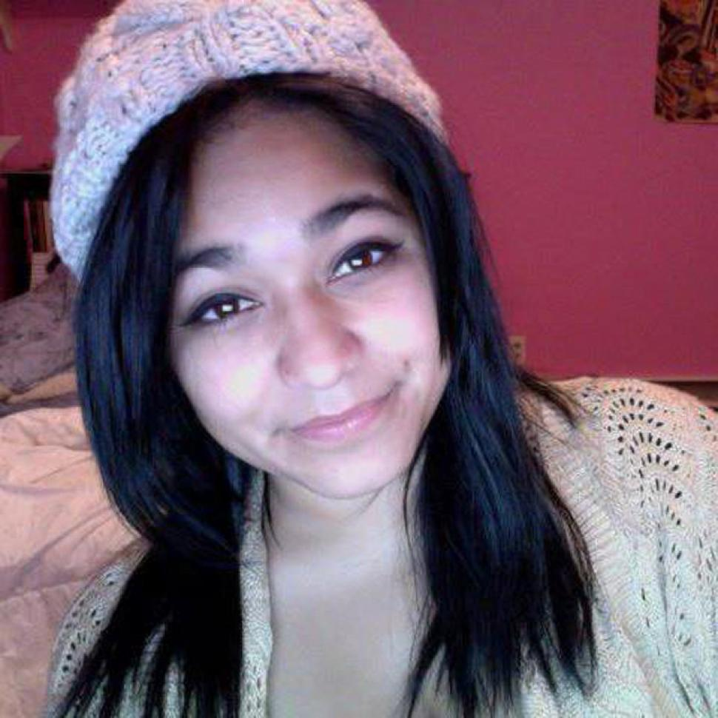
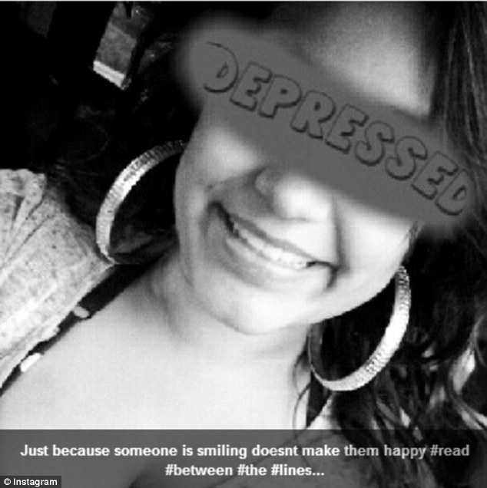
Felicia Garcia
Felicia,15 yrs. old was from New York. She experienced
bullying and harassment due to rumors that she slept with
members of the football team. She used Twitter, Instagram,
and Facebook to express herself, post pictures, and create
Images.
“I cant, Im done, I give up”
“Just because someone is smiling doesn't
make them happy”
Felicia jumped in front of a moving train on October 24th 2012

Slide 14
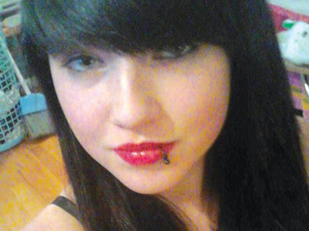
Amanda Cummings
Amanda Cummings was 15 yrs old from New York. Amanda was
The victim of bullying , had a history of depression, self-injurious
behaviors, and heart break over boys. Amanda used
Facebook to regularly express her feelings and left a goodbye
message on there.
“Im soo tired-______. Fml depressed mood too:(“
“…Ill die tonight crying over you".
"getting ready then im outa here. Im off this".
Amanda Jumped in front of a bus on December 27th 2012

Slide 15
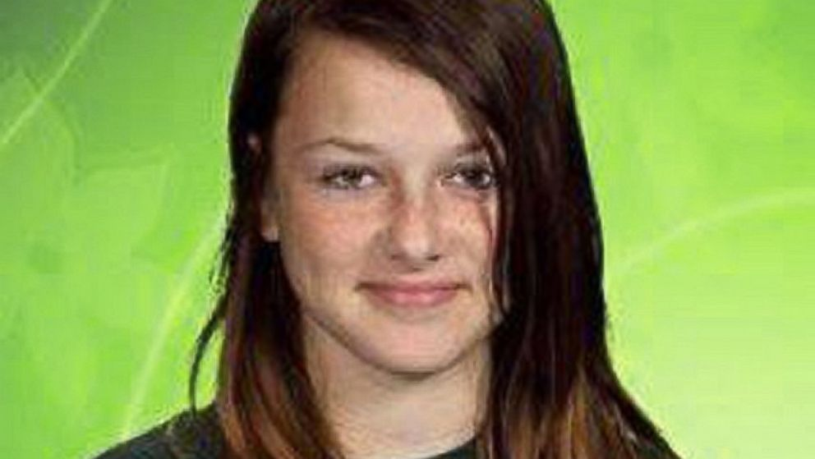
Rebecca Sedwick
Rebecca was a 12 year old from Lakeland, Florida. She was
cyber-bullied on all her social media sites (Facebook, Kik,
Twitter) causing her severe depression. Peers left message that she
should take her own life. She posted a final message on Facebook.
“I cant take it anymore”
“I’m jumping”
Rebecca jumped to her death in September 2013

Slide 16
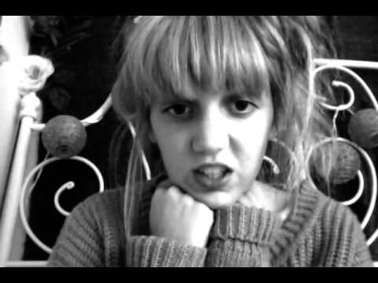
Olivia Penpraze
Olivia was 19 yrs. old and suffered depression and anxiety
since she was 14 yrs. old. She would post video logs of how
she was feeling on YouTube, Vblog, and Veimo ; expressing her
negative feelings and her distress from being bullied.
“The last few weeks everything is just going down and down, like how I feel”
““I can’t hide behind a fake smile, I can’t pretend that im okay”
““Im going to go away and no one will notice”
Olivia was taken off life support in April 2012

Slide 17
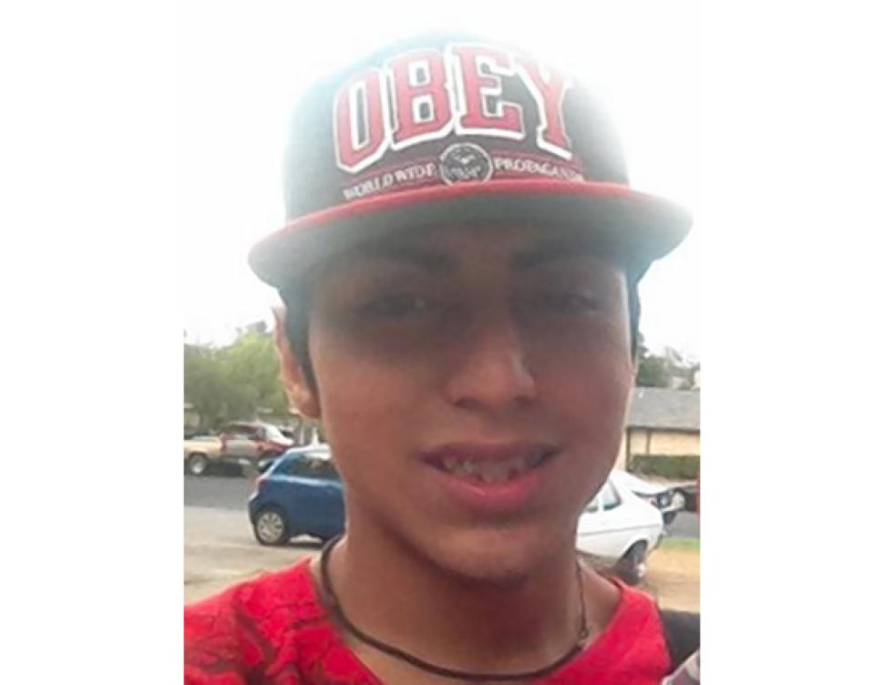
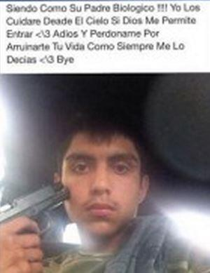
Adrian Alvaresz
Adrian was a 15 yr. old from Austin Texas. He used Facebook
regularly to send messages and post photos of himself.
He left a suicide note on Facebook.
“To all my friends I want to ask y'all for some
help. Help my mom stay strong…”
“I’m taking my life away cause everyone has
always put me to the side, I had try asking for
help. My life hasn’t been easy.”
“I just want to say I’m sorry.
Adrian shot himself on October 15th 2013

Slide 18
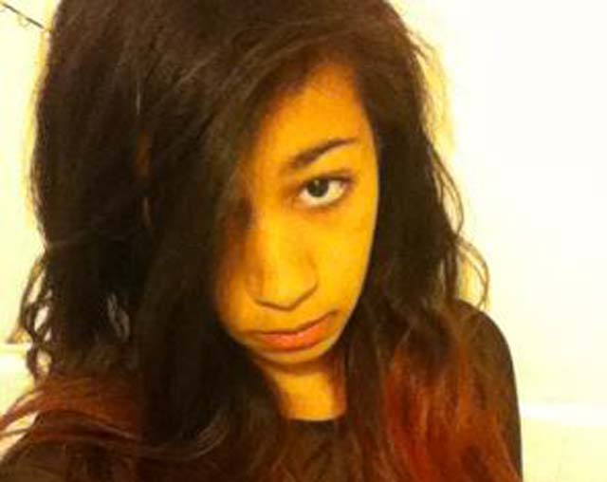
Jayah Jackson
Jayah was a 15 yr old living in New York City. She
Suffered online bullying via Facebook and Ask.fm.
Her peers would write hurtful messages, suggesting
that Jayah kill herself.
“I dont care anymore”
“I am not quiet, its just nobody talks to me, how would I not be quiet?
“Im actually just going to wait for someone to make a petition for me to
kill myself...because its inevitable..like we all see it coming”
Jayah jumped to her death in February 2014

Slide 19
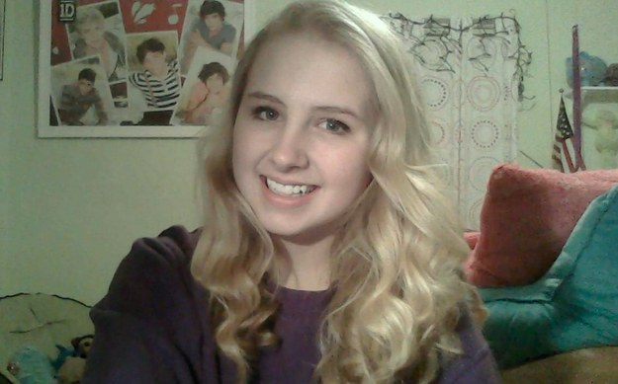
Maddie Yates
Maddie was 14 yrs old and from Kentucky. She suffering from depression
and anxiety. She was very active on social media sites such as YouTube
And Teen Ink, posting make-up tutorials and poems. Her postings
and videos started to escalate in volume and intensity. She posted a
Good-bye video on YouTube.
“I just can’t do it anymore”
“Sometimes it hurts so bad that I throw up, and sometimes I just get panic attacks”
“You can’t help me. You’ve tried. And I’m sorry. I really don’t mean to hurt anyone.
Remember that I’m doing you a favor.
Maddie took her life in April 2014

Slide 20
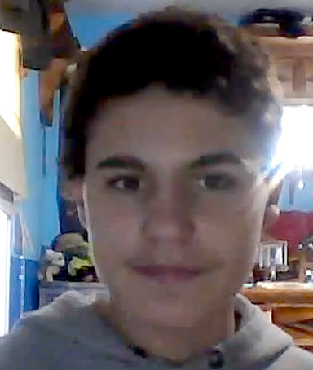
Jamey Rodeomeyer
Jamey was a 14 yr old from New York. He was openly gay,
and as a result suffered severe bullying by his classmates, online and at
School. Jamie advocated for gay rights via
YouTube and blogging. He posted his final goodbye message on tumblr.
"I always say how bullied I am, but no one listens. ... What do I
have to do so people will listen to me?”
"I just wanna say good bye, disappear with no one
knowing. ... I don't wanna live this lie, smiling to the world
unknowing”
Jamey took his life on September 18th 2011

Slide 21
Cross Case Comparison
Depression, emotional pain, loneliness, thwarted belongingness, and hopelessness were the most common symptoms expressed.
7 out of 10 posted suicide note online.
5 of the 7 youth took their life within 2 days of these messages being posted.
8 of the 10 youth were experiencing bullying
9 of the 10 youth reached out for help online
Key words were identified such as ‘tired’, ‘lonely’, and ‘can’t’.
5 of the 7 youth that posted a final suicide note online used the word ‘can’t’
Youth varied in their use of social media- sensitive, ‘creative’, ‘artistic’, and ‘emotional’ youth used it more often and expressed more intimate feelings and thoughts.

Slide 22
Conclusions
(1) Social media sites can record information like a personal journal.
(2) Social media sites can reveal the escalation of suicide ideation; tracking intensity and duration.
(2) Signs & symptoms of suicide can be expressed through words, images, and online behavior.
(3) Depression, emotional pain, loneliness, thwarted belongingness, and hopelessness were common symptoms expressed on-line
(4) Suicide notes can be left online- written, pictures, videos.
(4) Final good-bye messages have a crucial time line for intervention- 48 hrs.
(5) The word can’t is a key word indicating desperation.
(6) Personality differences impact how people use social media, show their signs of depression online, and thus trigger different responses.
(8) Social media sites can either provide support or increase the escalation process of depression and suicide
(9) bullying was a common factor contributing to thoughts of suicide for these youth

Slide 23
Educational Programs
Few programs in public schools that specifically address suicide.
Programs in colleges and universities are beginning with key support and service groups being targeted for participation.
Little focus on online signs and symptoms

Slide 24
Recommendations for educational programs/training about suicide
Should focus on social media and online environments.
Loneliness, depression, and hopelessness should be highlighted as key symptoms related to suicidal ideation; provide examples of key words, phrases one might use.
How signs and symptoms display in images and videos should be reviewed and discussed.
A full checklist should be adapted for online behaviors.
Differences in personality characteristics should be discussed in relation to how people use social media, react to negativity and mental health issues and ask for help.
Methods of identifying and immediately addressing good-bye messages should be included in awareness programs (crisis intervention)
Should discuss how to detect signs of the escalation process.
Review/discuss how social media can act as a support or escalate problems.
Review how bullying/cyberbullying can be a trigger and what to do about it; discuss the role of the bystander in an on-line environment.

Slide 25
Thank you
Jennifer Laffier
Senior Lecturer/ Therapist
University of Ontario Institute of technology
Oshawa, On., Canada.
T: 905-721-3111 ext: 2891
E: jennifer.laffier@uoit.ca

