Slide 1
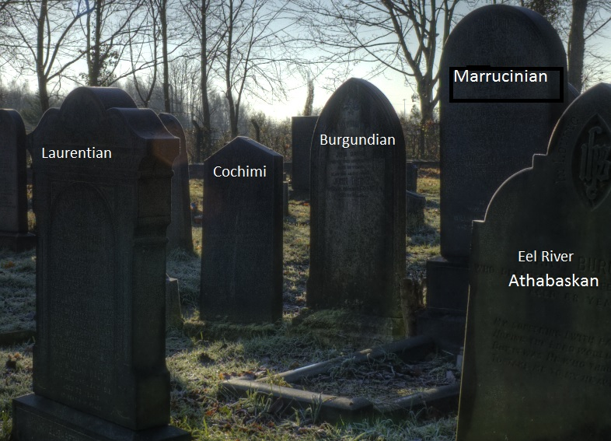
Endangered Languages
Essential or Sentimental?
Dr. Allyson Eamer, Faculty of Education, University of Ontario Institute of Technology

Slide 2

Language Shift and Loss
  I have this sense, rightly or wrongly, the language is locked back there in my brain. It’s not really forgotten; it’s just sleeping. The language is there, locked with other memories of childhood. Loss happened so gradually, like an old pair of underwear slipping down. The elastic goes and goes you’re not really conscious of it. Just a loosening of the bond. Kouritzin (2006)
  Songs from a Taboo Tongue
How does language shift / language loss happen?

Slide 3

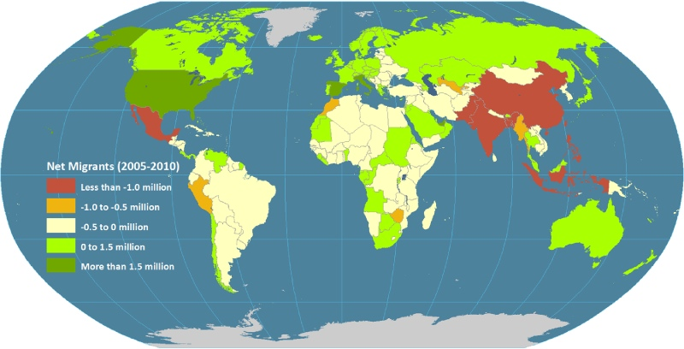
Migration, Colonialism, Expansionism, Shifting Borders, Displacement, Mandated Assimilation
Bratt-Paulston

Slide 4
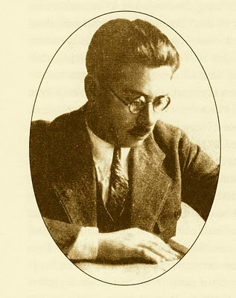
Language as a power struggle
A language is a dialect with an army and a navy.” Yiddish linguist Max Weinreich
The army and the navy are metaphors for the 21st century reality of the power wielded when education, governance, and health care are conducted in a dominant language.

Slide 5
Language Revitalization
Rescuing a language from near extinction due to colonialism, expansionism, assimilationist policy, migration (in diasporic communities)
and more recently… globalization

Slide 7
2005 United Nations World summit on the Information Society
…promote the inclusion of all peoples in the Information Society through the development and use of local and/or indigenous languages in ICTs. We will continue our efforts to protect and promote cultural diversity, as well as cultural identities, within the Information Society.

Slide 8
UNESCO’s 1996 Universal Declaration of Linguistic Rights:
Article 3 (1)
This Declaration considers the following to be inalienable personal rights which may be exercised in any situation: the right to be recognized as a member of a language community; the right to the use of one’s own language both in private and in public; the right to the use of one’s own name; the right to interrelate and associate with other members of one’s language community of origin; [and] the right to maintain and develop one’s own culture;
Article 7 (1&2)
All languages are the expression of a collective identity and of a distinct way of perceiving and describing reality and must therefore be able to enjoy the conditions required for their development in all functions. All languages are collectively constituted and are made available within a community for individual use as tools of cohesion, identification, communication and creative expression.

Slide 9

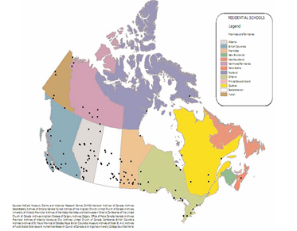
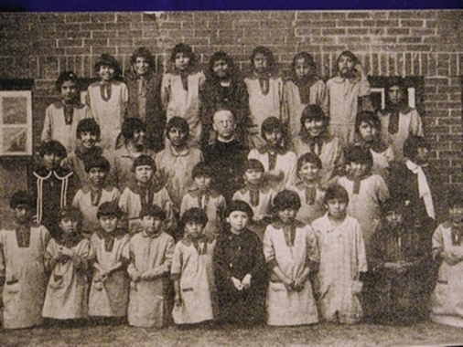
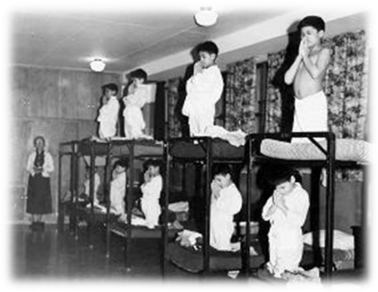
Canada, the U.S. and Australia
The legacy of residential schools for our aboriginal peoples
“kill the Indian in the child” by separating children from their parents in order to ‘civilize’ them, convert them to Christianity and replace their mother tongues with English (de Leeuw, 2009, p.124)

Slide 10

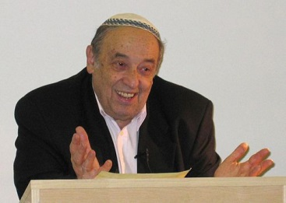
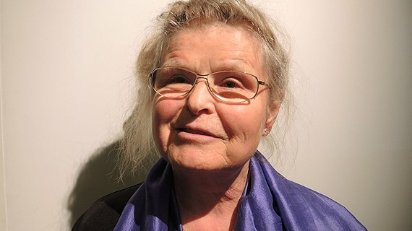
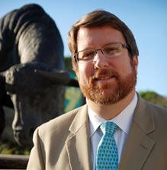
Fishman (1994)
… [N]o one can be a full-fledged, native - or even “native-like”- member of the culture and participate in these acts, events, occasions, and cultural processes without mastering the specific language in which they are implemented and lacking which they would not exist.
Essential
Osborn (2006)
As the study of natural sciences is vital to those who would live in and seek to understand our natural world, so the study of languages is indispensable for those who live in our social worlds. The former may be oriented toward technicist control, the latter toward under-standing and promoting social justice.
Skutnabb-Kangas (2002)
The loss of a language is the loss of a corpus of cultural knowledge because language is “the DNA of culture” .
Amartya Sen 1985 (Economics Nobel Laureate)
Dominant-language medium education for Indigenous, Tribal and Minority children often curtails the development of the children’s capabilities and perpetuates poverty (according to theories

Slide 11
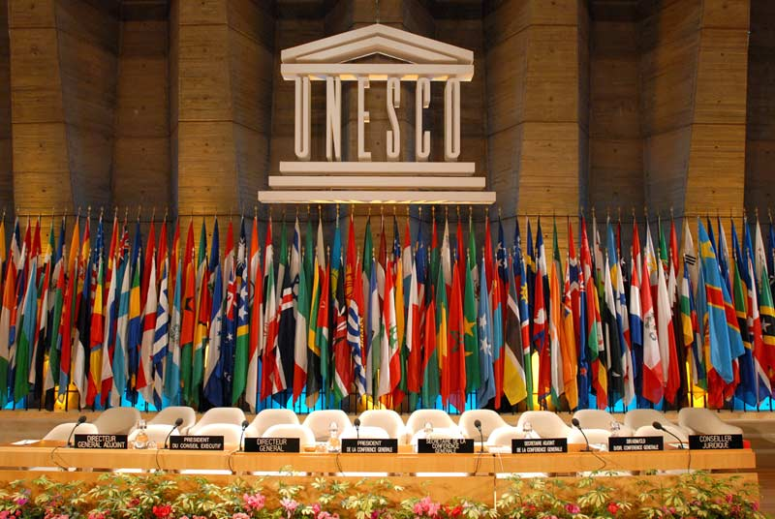
This Declaration considers the following to be inalienable personal rights which may be exercised in any situation: the right to be recognized as a member of a language community; the right to the use of one’s own language both in private and in public; the right to the use of one’s own name; the right to interrelate and associate with other members of one’s language community of origin; [and] the right to maintain and develop one’s own culture…
UNESCO 1996 Article 3(1)

Slide 12
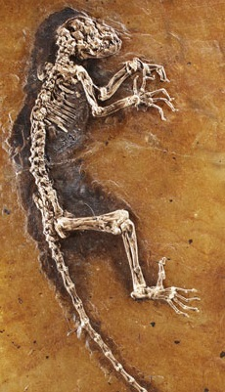
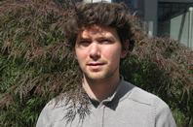
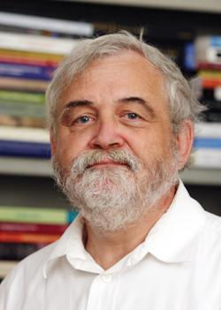

Sentimental
Edwards (1988)
If language is seen to be at risk, it is often because of a finely meshed social evolution. To remove it from risk would entail wholesale reworking of history, a broad reweaving of the social fabric.
Costa (2013)
Language activists, teachers and scholars have been duped by a “regime of truth” which essentializes the link between language and culture, romanticizes the benefits to humanity of linguistic diversity, and distracts from more pressing matters of injustice such as socio-economic inequities.
Davies (1996)
The support of language revitalization initiatives is really about easing our collective guilt for our colonialist history; while neglecting to acknowledge that it is through English that minority communities have access to the privileges of modernity.

Slide 13
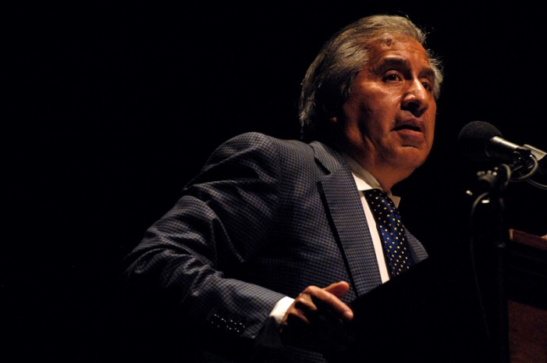
What they seem not to recognize is that, as a socially disadvantaged child, I regarded Spanish as a private language. It was a ghetto language that deepened and strengthened my feeling of public separateness. What I needed to learn in school was that I had the right, and the obligation, to speak the public language. … Without question it would have pleased me to have heard my teachers address me in Spanish when I entered the classroom. But I would have delayed – postponed for how long? – having to learn the language of public society. I would have evaded – and for how long? – learning the great lesson of school: that I had a public identity.
(Rodriguez, 1981)

Slide 14

So what’s new on the linguistic landscape?

Slide 15
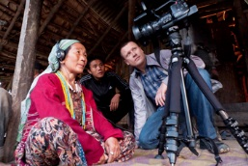
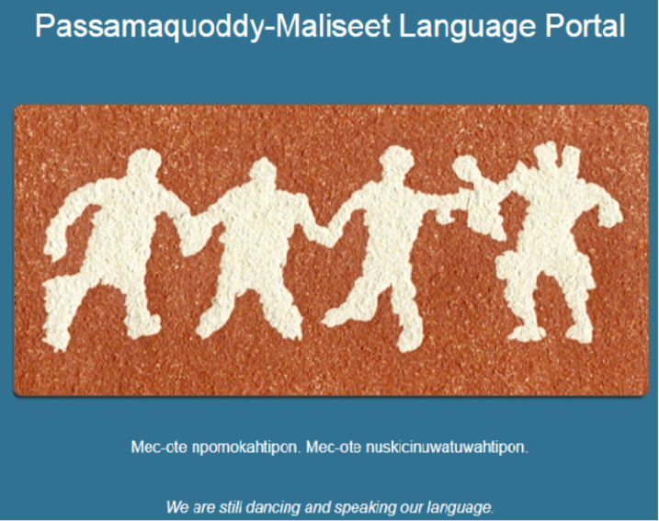
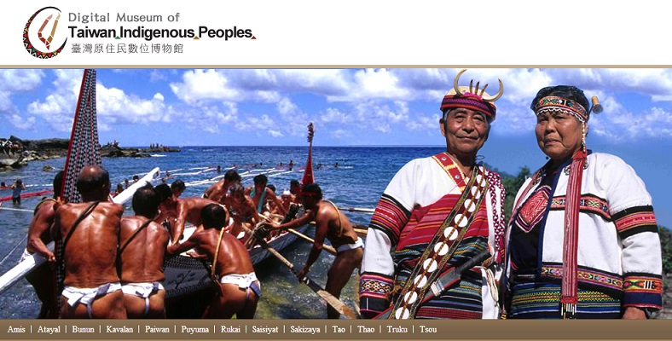
Language
Documentation
By scholars,
Governments and
Indigenous groups

Slide 16
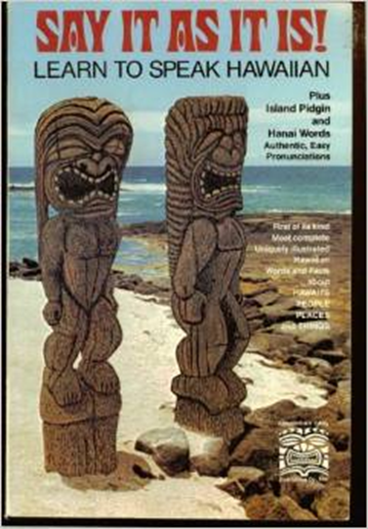
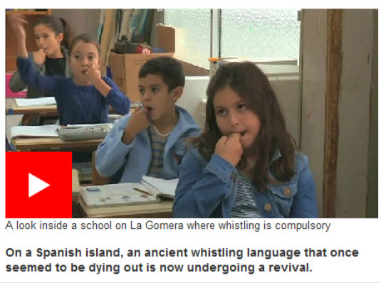

Slide 17
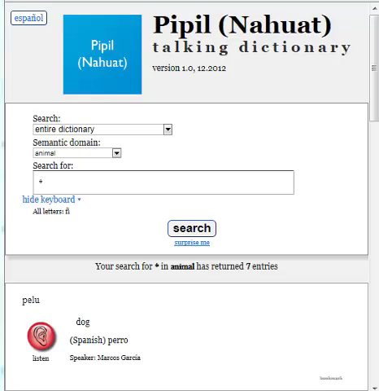
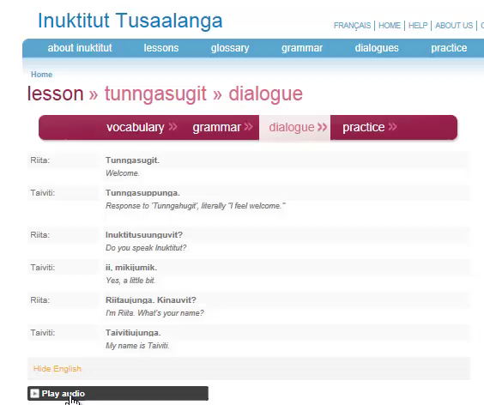

Slide 18
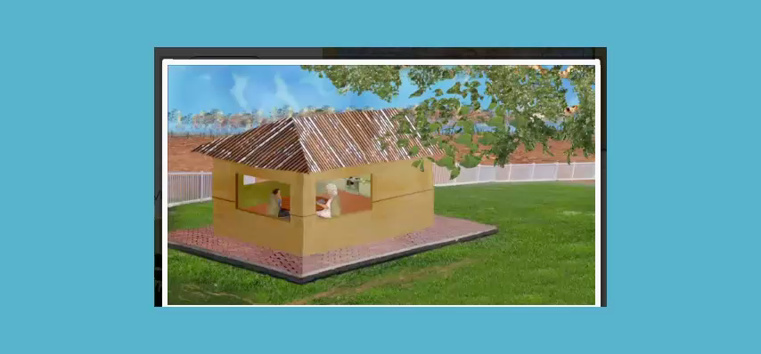

Slide 19
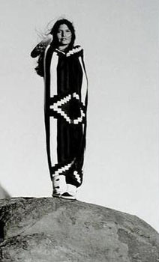

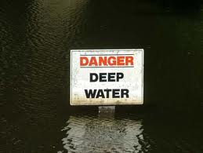
Review-ᐃ
ᒋ
ᒋᐢᑌᒪᐤ cistemaw
ᓯ
ᓯᑳᐠ sikâk
ᔨ
ᔨᐹᑎᓯᐣ yipâtisin
ᓂ
ᓂᐸᐤ nipaw
ᑭ
ᑭᓯᐣ kisin
ᒥ
ᒥᑖᑕᐦᐟ mitâtaht
ᐃ
ᐃᐢᑫᐧᐤ
ᐱ
ᐱᒥᕀ
ᑎ
ᑎᒦᐤ

Slide 20
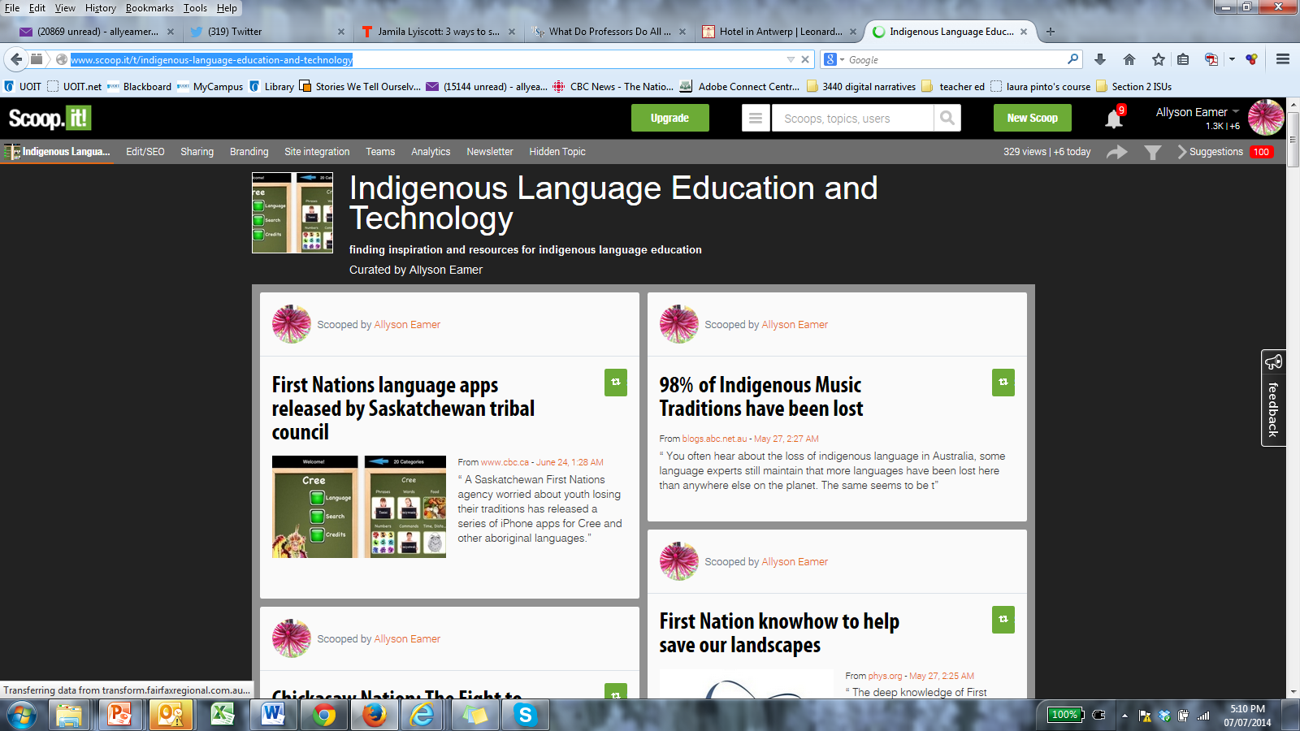
http://www.scoop.it/t/indigenous-language-education-and-technology

Slide 22
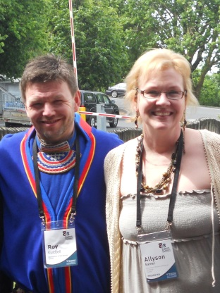
Europe
The Norwegian North Sàmi language has been programmed into downloadable dictionaries (http://giellatekno.uit.no/words/dicts/index.eng.html).
Gaelic bloggers are sharing tips on the use of the Irish language (http://blogs.transparent.com/irish/).
Students of Manx, the indigenous language of Isle of Man, are using smart phone and tablet apps to improve their proficiency (http://www.bbc.com/news/world-europe-isle-of-man-20392723)

Slide 23
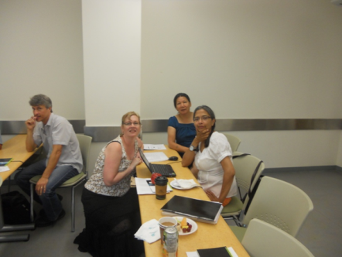
North America
A CD ROM self-study course has been developed in Navajo which is spoken in the South-West U.S. (http://shop.multilingualbooks.com/collections/navajo/talk-now).
Learners of Cherokee (spoken in the South-Central U.S.) can communicate within a virtual world (http://www.youtube.com/watch?v=tmP17acPYCE).
The Ojibwe of Manitoba, Canada are using an iPhone app to revitalize their language (http://fner.wordpress.com/2012/03/28/ojibway-language-iphone-ipad-app-ogoki-learning-systems-inc) as are the Winnebago in the Mid-West U.S. (http://bigstory.ap.org/article/save-endangered-languages-tribes-turn-tech).

Slide 24
Africa
Orthographies and databases are being developed for oral languages in Kenya (Wamalwa and Ouloch 2013).
Ancient stories are being recorded in the indigenous languages of Mali (http://www.youtube.com/watch?v=GHB-yMoDhYo).
An online language learning company (busuu.com) is offering a course in the whistle language of the Canary Islands (http://www.youtube.com/watch?v =jkGwzFYj6dE).

Slide 25
Central and South America
Ground breaking language documentation of the Kĩsêdjê language is being done in Brazil (http://web.mit.edu/newsoffice/2013/student-profile-rafael-nonato-0722.html).
A talking dictionary of the Pipil language of El Salvador has been developed (http://talkingdictionary.swarthmore.edu/pipil/).
Recordings of personal narratives of the Aché people in Paraguay are being made (http://dobes.mpi.nl/projects/ache/project/).

Slide 26
Asia
Digital storytelling software now includes some of the minority languages of China (http://www.chinasmack.com/2013/stories/phonemica-americans-mapping-and-preserving-chinese-dialects.html).
Folklore recordings and an online dictionary have been completed for the Ainu language of Japan (http://scholarspace.manoa.hawaii.edu/bitstream/handle/ 10125/5110/5110.pdf?sequence=2).
Lessons in the Tajik language of Uzbekistan are now available on YouTube (http://www.youtube.com/watch?v=iWlSuuGMMbc)

Slide 27
Arctic
Asynchronous online lessons are available in Inuktitut, one of the languages of the Arctic (www.tusaalanga.ca/lesson/lessons).
Middle East
Online storytelling in Chaldean, spoken in Iraq, can help speakers achieve fluency (http://elalliance.org/projects/languages-of-the-middle-east/neo-aramaic/).

Slide 28
Pacific
Indigenous sign language from Central Australia can now be learned via online videos (http://iltyemiltyem.com/sign/).
An online dictionary has been created for the Rapa Nui language of Easter Island (Makihara, 2004)
Digital storytelling in Pacific Island languages are available through http://italklibrary.com/

Slide 29
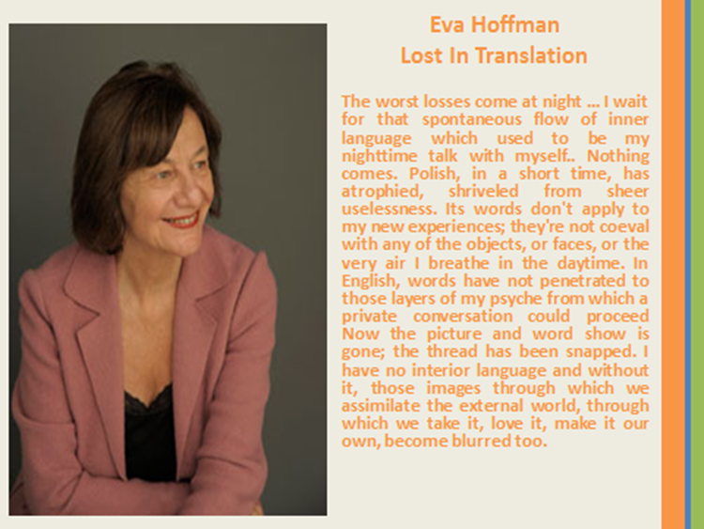

Slide 30
Thank you for your interest.
Now over to you for questions…
Dr. Allyson Eamer
Faculty of Education
UOIT
Ontario, Canada

