Slide 1
Is
there
APP
an
for that?
Considering the quality of early math apps
Ann LeSage
Faculty of Education

Slide 2
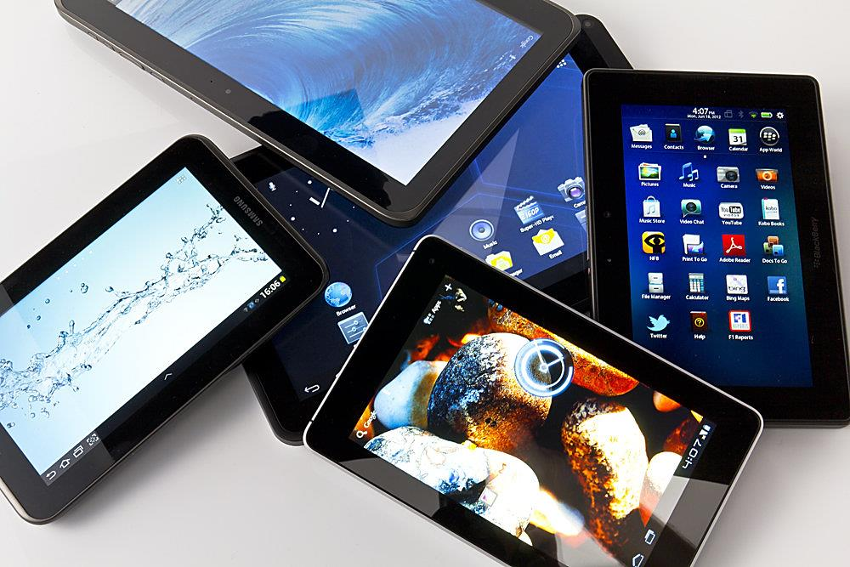
A few App Facts …

Slide 3
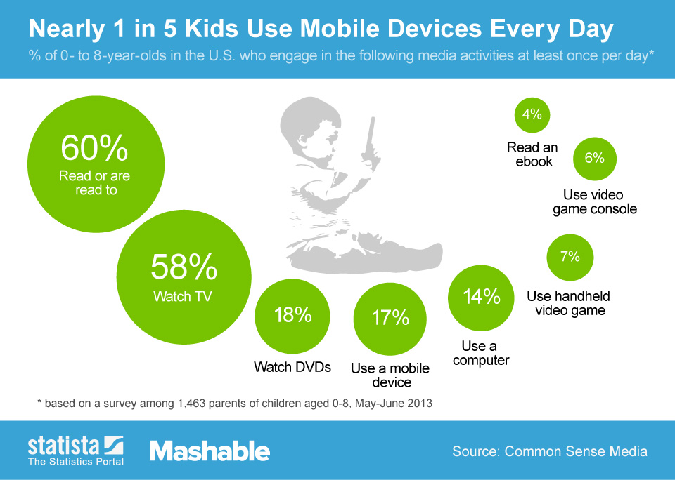

Slide 4
“Education Category” of iTunes™…
In 2009, 47% of the top selling education apps targeted toddlers & preschool children … by 2012 this number increased to 72%
Many “educational app” target young children
(e.g., TV character / show, fast paced animation, bright colours, etc.)
What Criteria?
iTunes Apps: Has criteria / guidelines for acceptance (as of Sept 2010) … BUT, … developers determine the app category
Android Apps: No approval process or guidelines
… developers pay a fee, submit app description & screenshots of app

Slide 5
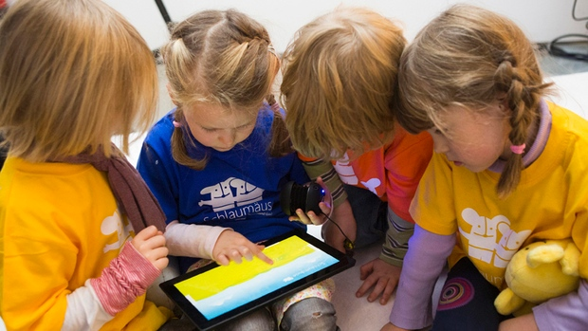
… what criteria might we consider to assess the quality of early education apps?

Slide 7
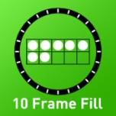
Preschool Genius Math Booster Zoo
Explore counting, patterning, size, addition &subtraction at the zoo.
https://itunes.apple.com/us/app/preschool-genius-math-booster/id776479737?mt=8
https://play.google.com/store/apps/details?id=com.OneMonkClapping.MathBoosterZoo&hl=en
Tens Frame Fill
Children use a Tens Frame to explore groupings of ten with pictures alone, or parents can modify the format to show the addition / subtraction sentence that represents the picture.
https://itunes.apple.com/ca/app/10-frame-fill/id418083871?mt=8

Slide 8
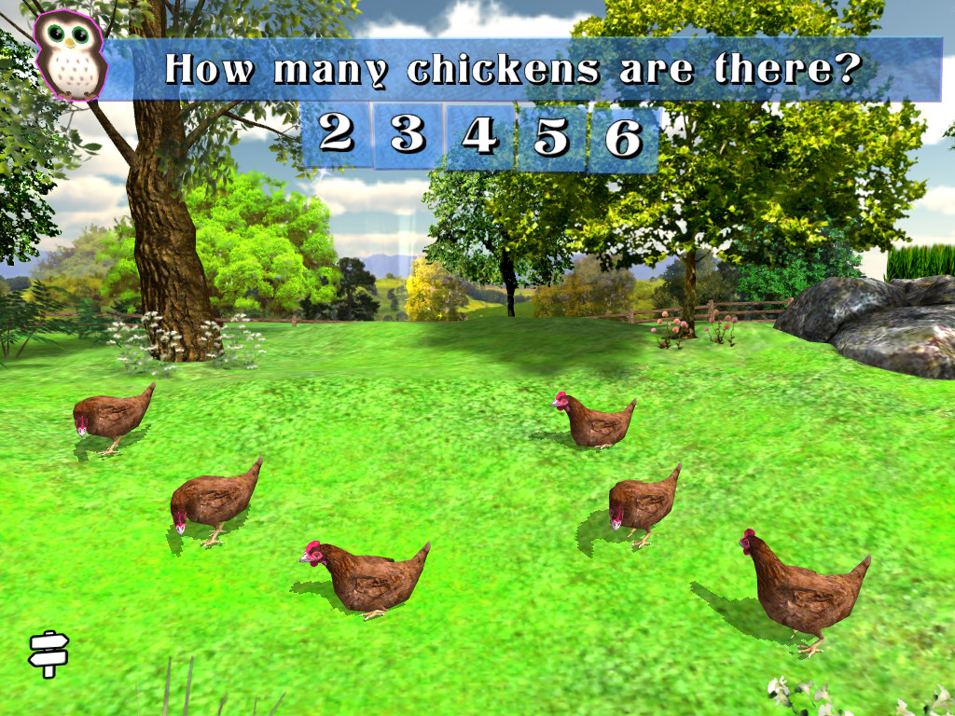
Preschool Genius Math Booster Zoo

Slide 9
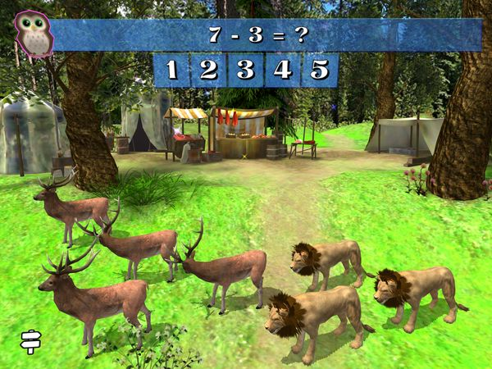
Preschool Genius Math Booster Zoo

Slide 10
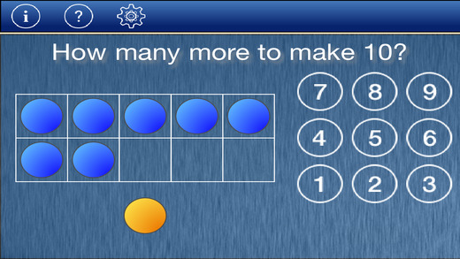
Tens Frame Fill

Slide 11
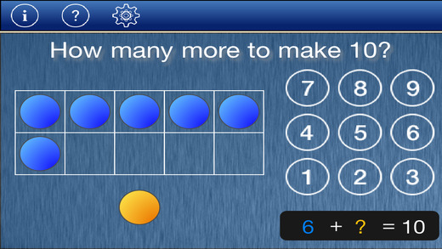

Slide 12
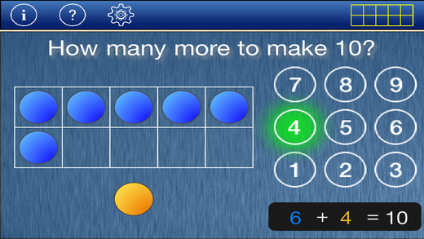

Slide 13
Tens Frame Fill

Slide 14
Questions?
Contact information: ann.lesage@uoit.ca

