Slide 1
Research Data Management Survey - Summary

Slide 2
Faculty and Academic Status
Academic Status | No of Responses
Faculty Member | 51
Graduate Student | 12
Postdoctoral Fellows | 2
Dean | 1
Research Associate | 1
Unidentified | 8
Total | 75
Faculty | No. of Responses
FED | 6
FBIT | 10
FEAS | 14
FHSci | 25
FSci | 12
FSSH | 8
Total | 75
Survey Response: N = 75

Slide 3
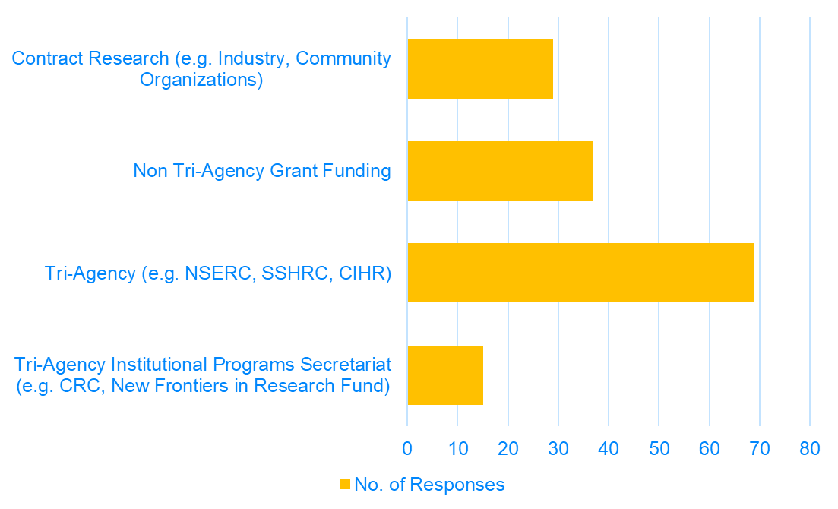
Do you currently hold, or are you planning to apply for research funding in the next two years?
92% (69) researchers indicated that they have applied or will apply for Tri-agency funding in near future.
39% indicated their research funding comes from working with industry and community organizations.
More than 1 option could be selected in this question.

Slide 4
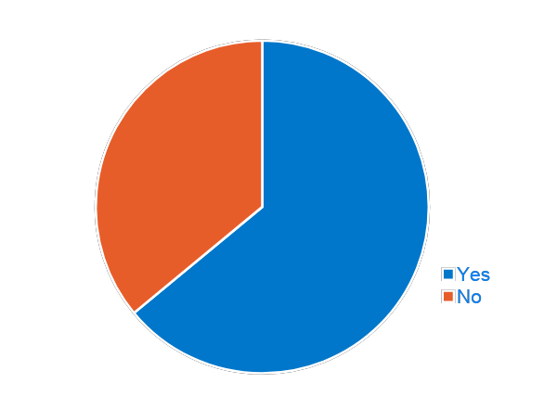
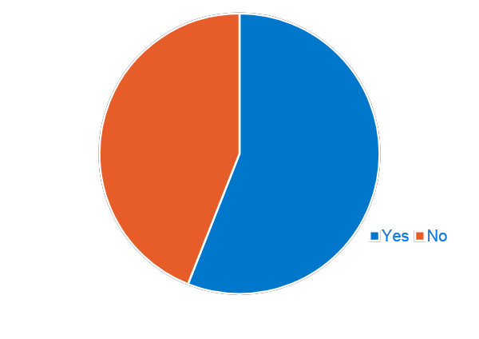
Sensitive Data in Research
Tri-Agency Research Data Management Policy Awareness
75 responses in total (42 – Yes; 33 - No)
56% are aware of the Tri-Agency Research Data Management Policy that will require applicants to complete Data Management Plans and eventually deposit research data.
56% of researchers conveyed that their research generates sensitive data.
75 responses in total (48 – Yes, 27 - No).

Slide 5
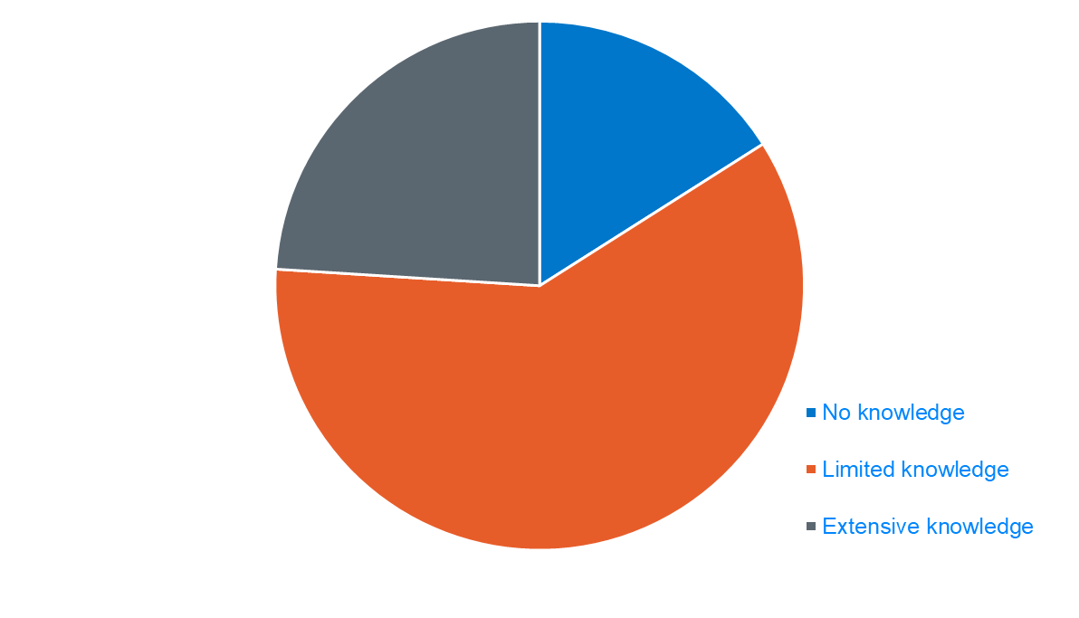
Current Level of Knowledge in Developing Research Data Management Plans
76% of the researchers have limited or no knowledge of the in developing and implementing data management plans.

Slide 6
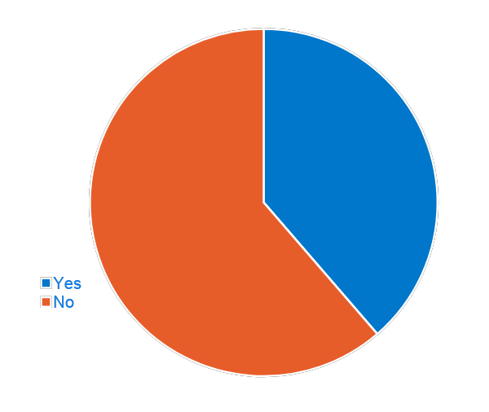
Have you ever completed a data management plan (DMP)?
38% have completed at least 1 DMP in last 5 years.
Of those 38% (29), 58% (17) have completed less than or equal to 2 DMPs and 14% (4) have completed more than 5 DMPs.

Slide 7
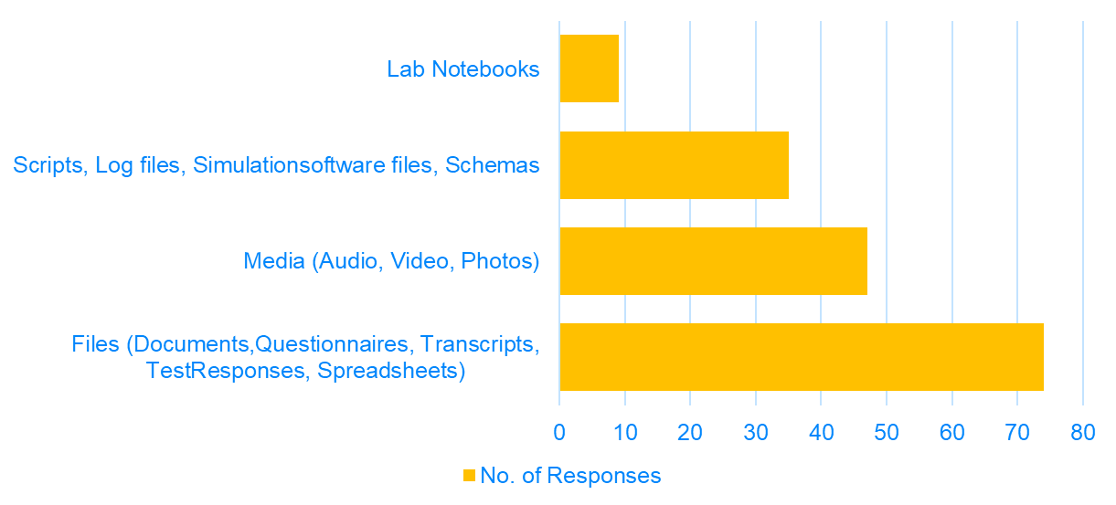
Data Format Collected During Research
Most common format of data collected during research is files followed by Media both Audio and Visual.
More than 1 option could be selected in this question.

Slide 8
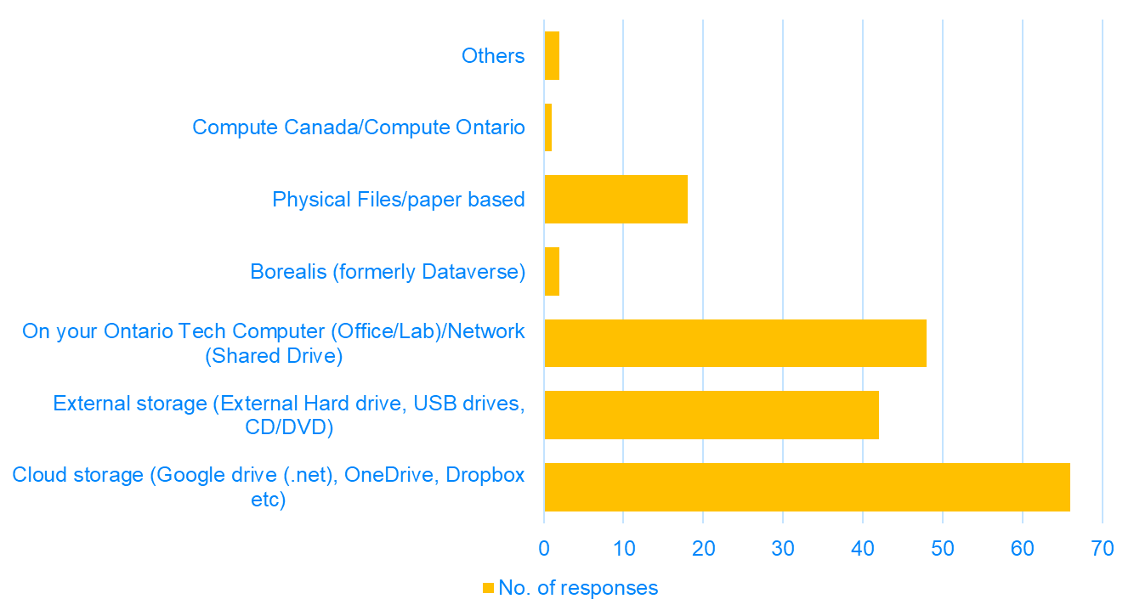
Research Data Storage
Most common way of storing among Ontario Tech researchers is Cloud storage followed by Lab computers or Network drives.
Cloud Storage Provider | No. of Responses
Google Drive | 67
Dropbox | 14
One drive | 11
Compute Canada | 1
Others | 3
More than 1 option could be selected in this question.

Slide 9
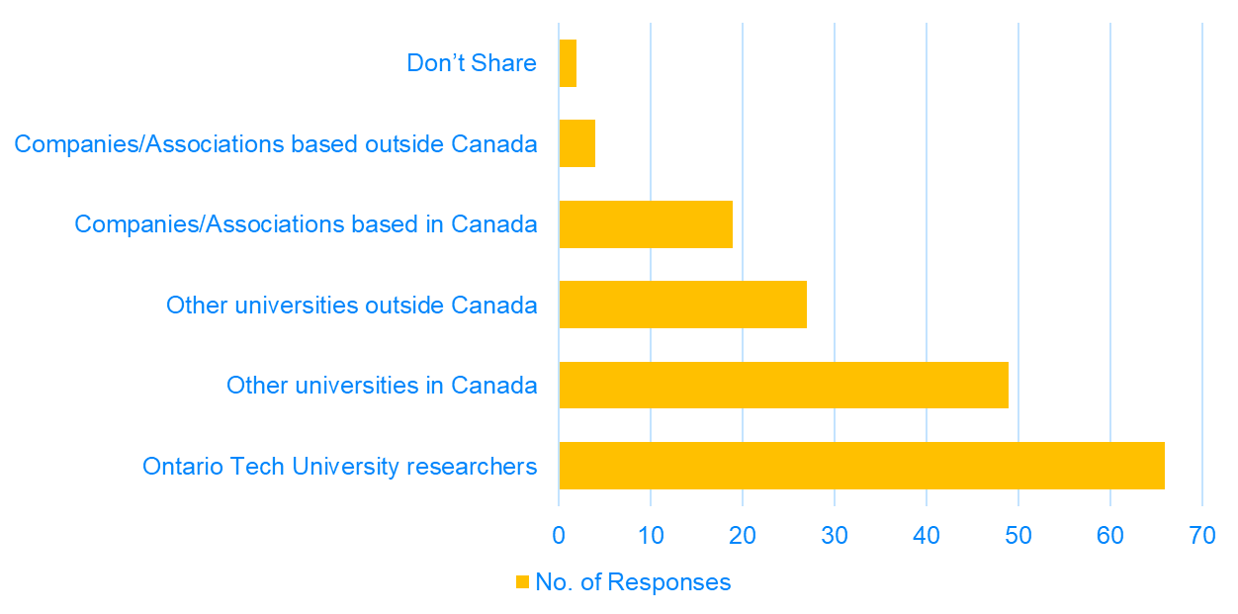
Sharing Research for Collaborative Purposes
Most Common way of sharing data is cloud services and emails.
1 researcher uses the university provided Synaman (filetransfer.dc-uoit.ca) service.
More than 1 option could be selected in this question.

Slide 10
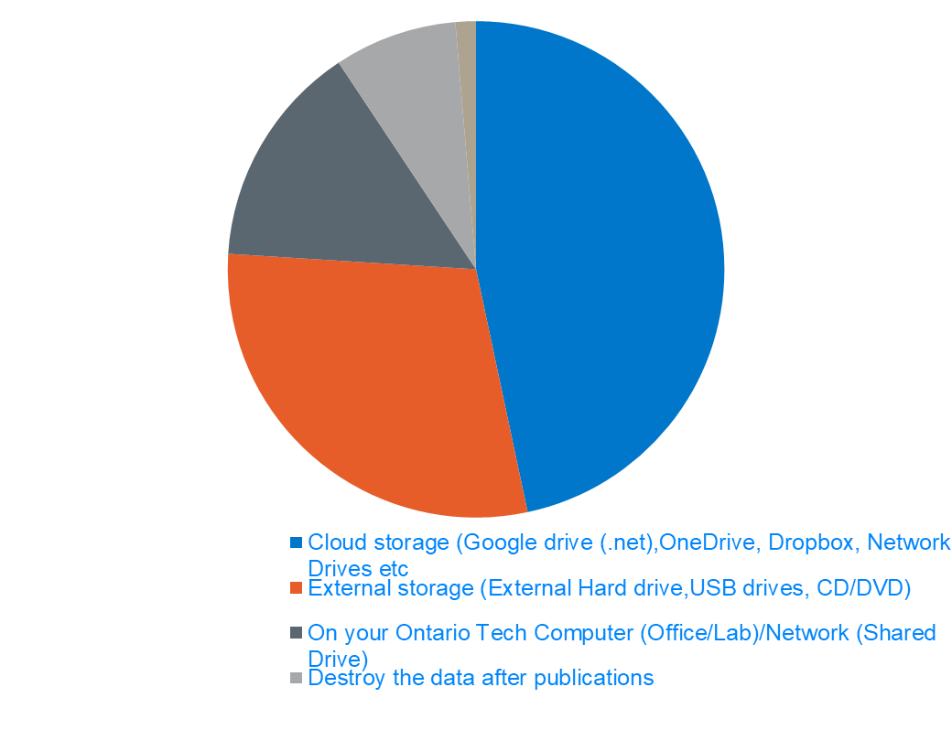
Long Term Archiving of Research Data
Cloud storage is most common choice for long term archiving of the research data followed by external hard drives.

Slide 11
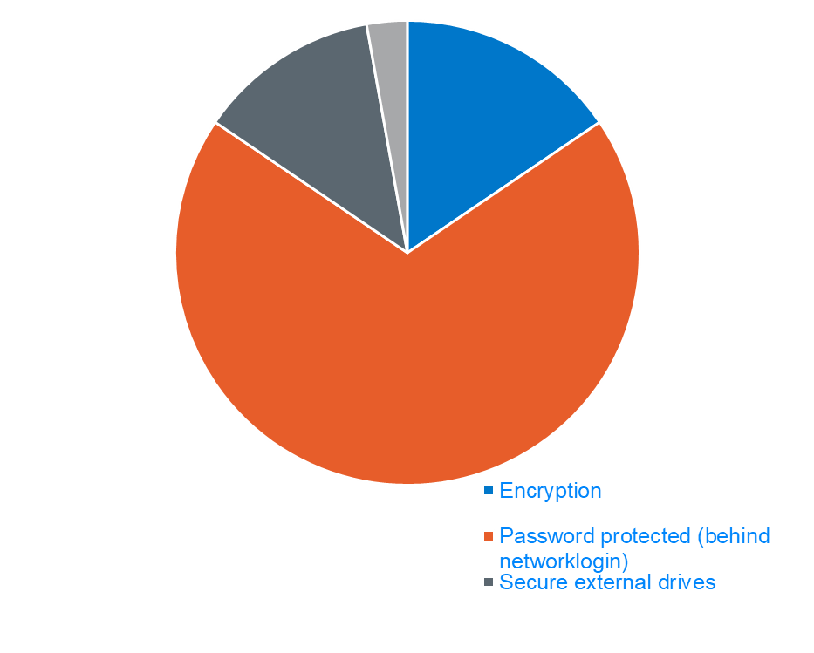
Data Security
Password protecting data behind network folders or password protected folders is the most common choice.
Researchers also make use of secure external drives for securing data.

Slide 12
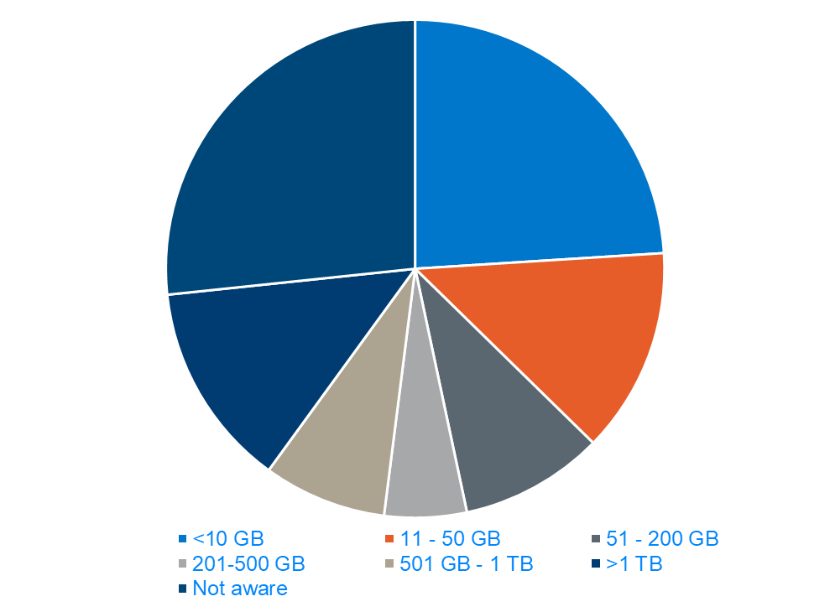
Data Generated in a Single Project
24% researchers generate less than 10 GB in a single project.
26% of researchers are not aware of how much data is generated in a single project by them.
More than 50% (38) of the researchers only have 1 backup of their data, 30% (23) have 2 backups, 12% (9) have more than 3 while 6% (5) have no backups of their research data.

Slide 13
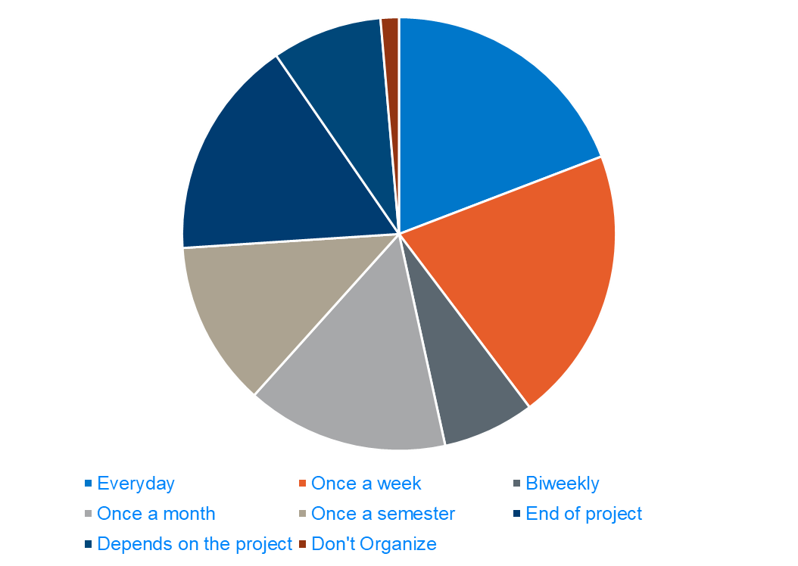
Saving and Organizing Data Intervals
19% (14) researchers save and organize their research data everyday
20% (15) do it once a week and the same number organize data at end of project
8% (6) do it based on the needs of the project.

Slide 14
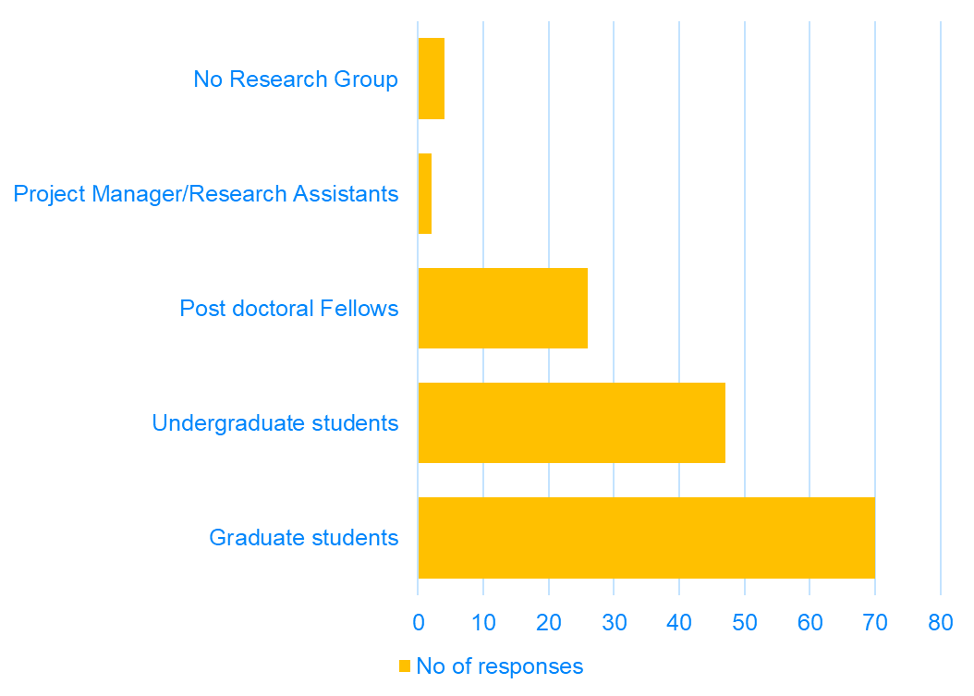
Research Lab/Group
70 researchers indicated that their research group consists of Graduate students, 47 responded with Undergraduate students and 26 have post doctoral fellows in their research group.
More than 1 option could be selected in this question.

Slide 15
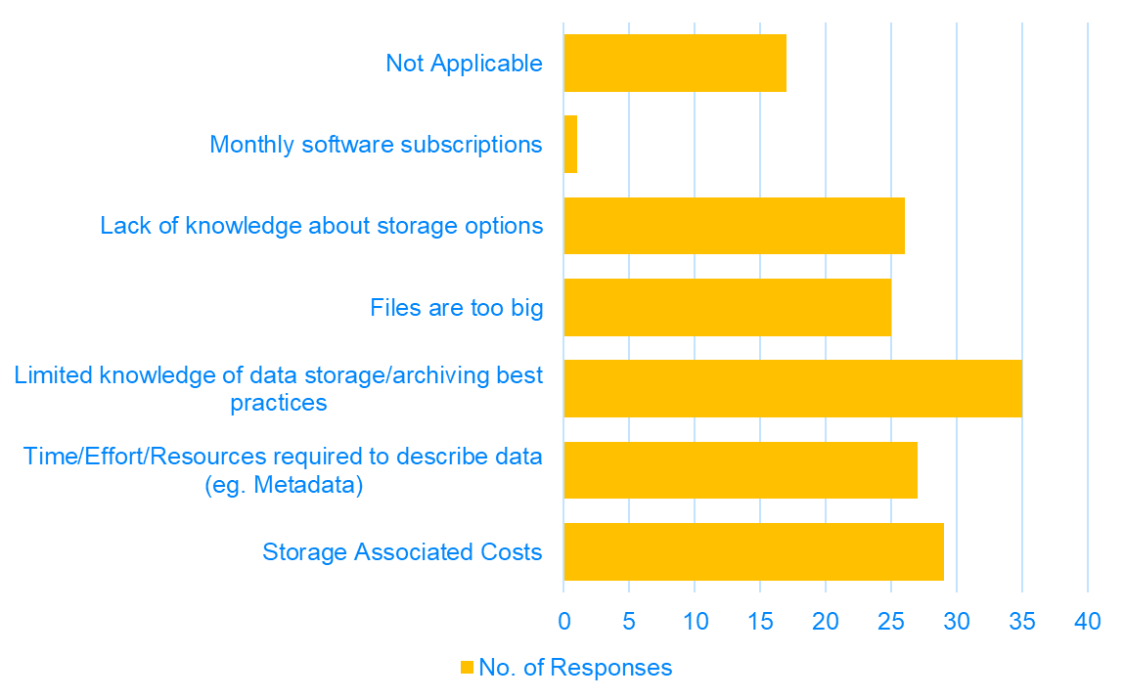
Challenges in Maintaining Research Data
Biggest challenge faced by researchers in maintaining their data is limited knowledge about their options and archiving best practices.
Cost associated with storage and Time required to generate metadata also cause issues when maintaining data.
44% (33) researchers also indicated that they produce enough documentation for other researchers to reproduce their research and 48% (36) were not sure if they did.
More than 1 option could be selected in this question.

Slide 16
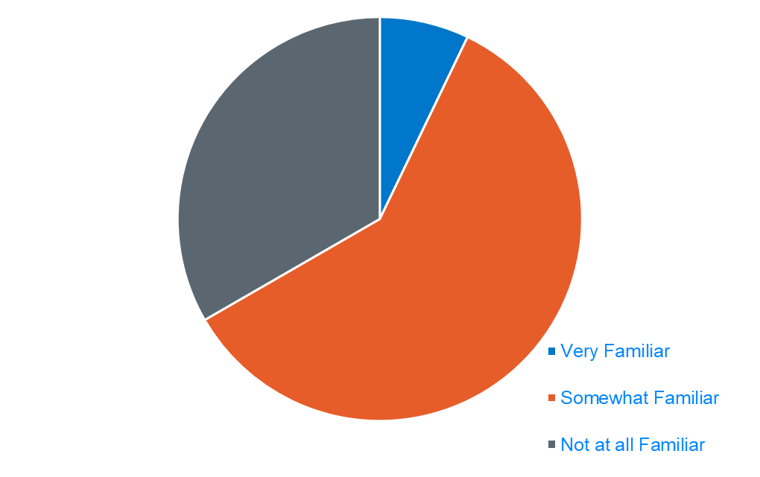
Familiarity with Existing Supports for RDM at Ontario Tech
96% (72) researchers are not familiar or somewhat familiar with Ontario Tech supports for RDM while only 2 researchers indicated they are very familiar with Ontario Tech supports.
86% of researchers also showed willingness to participate in training on how to write a DMP.

Slide 17
Recommendations for RDM at Ontario Tech
Documentation, training (workshops/guides), standard templates and prefilled samples of existing DMPs.
Dedicated data management team for consultations regarding data management and maintaining data archives (Better support from IT).
Secure data storage options and guidelines regarding storing consent paperwork.
Clear concise guidelines providing recommendations on what kind of data goes where and the kind of security associated with them.
Research Committee Consultations:
Critical to align REB DMP requirements with broader university requirements and Tri-Agency requirements.
Goal to reduce administrative burden for REB and faculty members and support efficiencies.

Slide 18
Thank You

