Slide 1

Research Fund / PD Report Using Fast

Slide 2
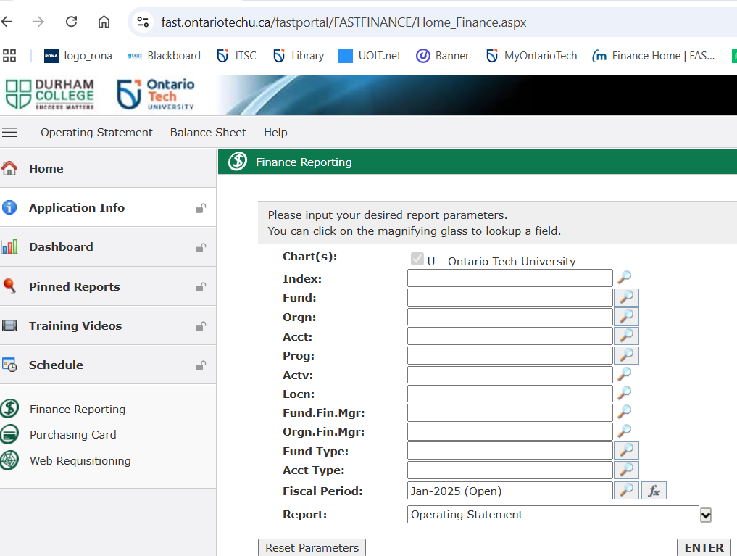
Running Fund Reports Using Fast log into Fast → default home page

Slide 3
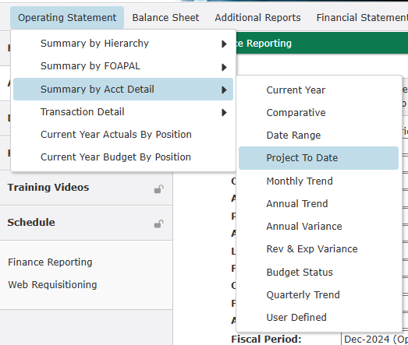
1. Research Fund → Select Summary by Acct Detail, then Project to Date

Slide 4
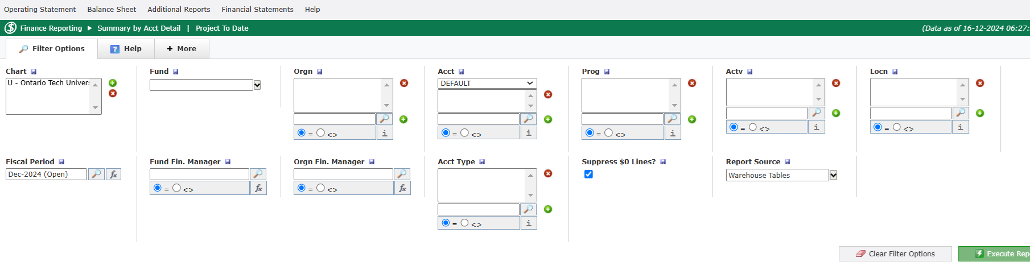
2. Populate Fund and checkmark Suppress $0 Lines, then Execute Report

Slide 5
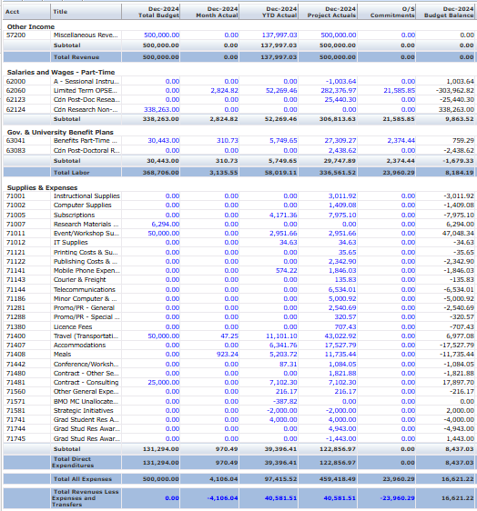
3. Fast will generate PTD report (or whichever date range parameter was selected)
Project to date balance including outstanding future commitments
Project to date balance

Slide 6
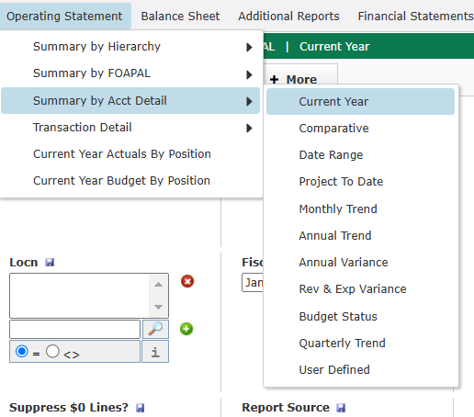
4. PD Fund → Select Summary by Acct Detail, then Current Year

Slide 7
5. Similar procedure for PD Fund → Populate Fund, Org (3169) and checkmark Suppress $0 Lines, then Execute Report

Slide 8
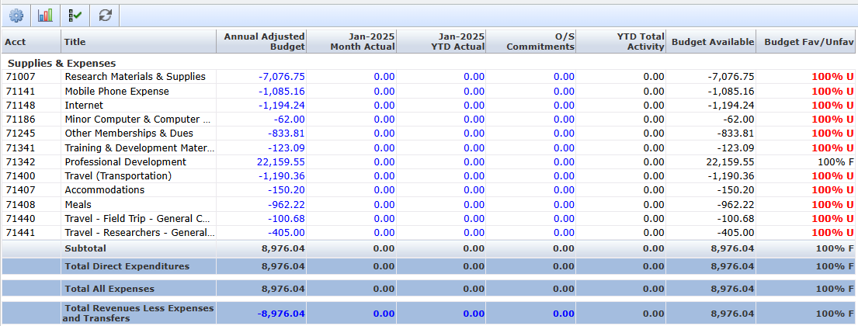
6. Click on 3169 to view your current year PD fund details
CY remaining balance is comprised of the current year PD
allocation plus 3 prior years as per the C.A, less expenses.
We distribute PD annually in the beginning of July.

